Slide 1

Cloud Computing
Prof.dr Veljko Milutinović
vm@etf.rs
Marko Dobromirović mare.d@hotmail.com
Miroslav Tišma tisma.etf@gmail.com

Slide 2
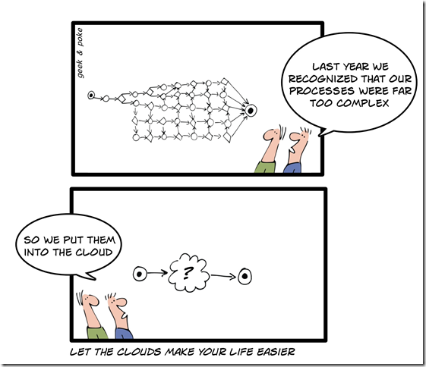
What is Cloud Computing?
The 5th Generation of Computing
(after Mainframe, Personal Computer,
Client-Server Computing, Web)

Slide 3
What is Cloud Computing?
(continued)
National Institute of Standards (NIST) definition:
  Cloud computing is a model for enabling convenient, on-demand network access to a shared pool of configurable computing resources (e.g., networks, servers, storage, applications, and services) that can be rapidly provisioned and released with minimal management effort or service provider interaction.‖

Slide 4
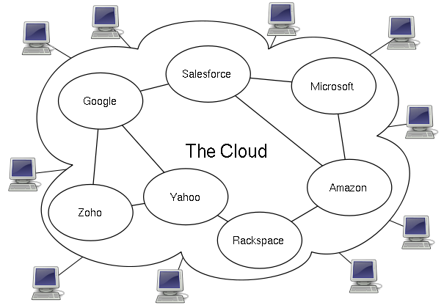
What is Cloud Computing?

Slide 5
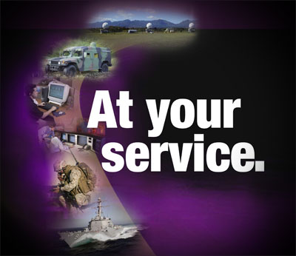
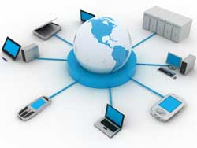

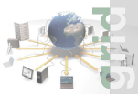
Evolution of Cloud Computing
Cloud Computing
SaaS Computing
Utility Computing
Next-Generation
Internet computing
Next-Generation
Data Centers
Grid Computing
Network-based
subscriptions
to applications
Gained momentum
in 2001
Offering
computing
resources as a
metered
service
Introduced in
late 1990s
Solving large
problems with
Parallel
computing
Made
mainstream
By Global
Alliance

Slide 6
Why Cloud Computing?
Customer Perspective
Economics
Applications can be accessed from anywhere, anytime
Faster, simpler, cheaper to use cloud applications
No upfront capital required for servers and storage
No ongoing operational expenses for running datacenter

Slide 7
Why Cloud Computing?
Provider Perspective
Economics
Easier for application vendors to reach new customers
Ability to use commodity server and storage hardware
Ability to drive down data center operational costs
Lowest cost way of delivering and supporting applications

Slide 8
Basic Model of a Cloud
Cloud is composed of:
  5 essential characteristics
  3 service models
  4 deployment models

Slide 9
Essential Characteristics
On-demand self-service
(whenever customer needs to change settings)
Resource pooling
(whenever customer needs to use resources)
Rapid elasticity
(whenever customer wants to expand or shrink)
Measured service
(customers pays exactly what they need)
Broad network access
(access from anywhere, anytime)

Slide 10


Service Models
SaaS
(Software as a Service)
  Vendor software is delivered as a service
IaaS
(Infrastructure as a Service)
  CPU, servers, memory, networks, storage, system software, etc. are delivered as a service
Service
Models
PaaS
(Platform as a Service)
  Provides virtualized servers for app running and developing – no maintenance of operating systems, server hardware, load balance or computing capacity

Slide 11
SaaS (Software as a Service)
Applications (word processor, CRM, etc.) or application services (schedule, calendar, etc.) execute in the “cloud” using the interconnectivity of the internet to propagate data
Custom services are combined with 3rd party commercial services via orchestration (SOA) to create new applications
Requires investment to build an enabling layer with governance, security and data management functionality
May require integration with back-office systems
Pay-as-you-go model

Slide 12
What are the benefits & challenges of SaaS?
  Benefits
Speed
Reduced up-front cost, potential for reduced lifetime cost
Transfer of some/all support obligations
Elimination of licensing risk
Elimination of version compatibility
Reduced hardware footprint
Challenges
Extension of the security model to the provider (data privacy and ownership)
Governance and billing management
Synchronization of client and vendor migrations
Integrated end-user support
Scalability

Slide 13
PaaS (Platform as a Service)
Applications are built in the “cloud” on the platform using a variety of technologies
Simplifies orchestration of cloud services
Development, testing, and production environments (servers, storage, bandwidth, etc.) are billed monthly like hosting
Pay-as-you-go model
Environments scale up & down at the click of a button
Concerns include code & data privacy, security and scalability

Slide 14
What are the benefits & challenges of PaaS?
  Benefits
Pay-as-you-go for development, test, and production environments
Enables developers to focus on application code
Instant global platform
Elimination of H/W dependencies and capacity concerns
Inherent scalability
Simplified deployment model
Challenges
Governance
Tie-in to the vendor
Extension of the security model to the provider
Connectivity
Reliance on 3rd party SLA’s

Slide 15
(IaaS) Infrastructure as a Service
Compute resources (processors, memory, storage, bandwidth, etc.) are provided in an as-needed, pay-as-you-go model
Able to provide from single server up to entire data centers
Creates new opportunities such as Cloud bursting: shifting usage spike traffic to alternate resources
Infrastructure scales up and down quickly to meet demand
Built on a utility computing architecture to host a SOA application layer

Slide 16
What are the benefits & challenges IaaS?
  Benefits
Systems managed by SLA should equate to fewer breaches
Higher return on assets through higher utilization
Reduced cost driven by
  Less hardware
  Less floor space from smaller hardware footprint
  Higher level of automation from fewer administrators
  Lower power consumption
Able to match consumption to demand
Challenges
Portability of applications
Maturity of systems management tools
Integration across the Cloud boundary
Extension of internal security models

Slide 17
Common Technology Architecture
Distributed
Mainframe
System
Mgmt
Clients
Clients
Security
Browser
Client
Mobile Device
Remote
Terminal
Browser
Applications
Applications
AAA
Network Management
Profiles
Transaction
Batch
Real Time
Productivity
Batch
Transaction
Services
Identity Mgmt
Admin Console
Directory
Orchestration
Service Monitoring
Service Management
Hosting Provider
Integration
Integration
Hardware
MOM
RPC
ESB
TCP Sockets
Transaction Management
Transaction Management
File Exchange
MOM
Intrusion Detection
Support
Health Monitoring
Data
Data
Federated Management
RDBMS
Flat Files
Content Management
Security
VSAM
RDBMS
Software Defense
Backup
Hardware
Hardware
WIntel
SSD
VLAN
Mainframe
DASD
VLAN
Outsourcer
Perimeter Defense
Application
Linux
SAN
Tape
Support
HP-UX / AIX / Solaris
NAS
Legacy O/S
Tape
Optical

Slide 18
Cloud Computing Reference Architecture
SaaS Cloud
Application
Management
Data Management
Service Level
Mgmt
Support
Billing & Metering
Security
System
Mgmt
Clients
Security
PaaS Cloud
Browser
Client
Mobile Device
Remote
Security
Provisioning
Billing & Metering
AAA
Service Level Mgmt
Applications
Platform Management
Service Level
Mgmt
Support
Profiles
Transaction
Batch
Productivity
Real Time
PaaS
Health Monitoring
Services
Identity Mgmt
Directory
Orchestration
Service Monitoring
Service Management
Integration
Intrusion Detection
Provisioning & Orchestration
MOM
RPC
ESB
TCP Sockets
Transaction Management
File Exchange
Data
External IaaS Cloud
Scheduling
Federated Management
RDBMS
Flat Files
Content Management
Security
Software Defense
Security
Provisioning
Billing & Metering
Environment Management
Service Level
Mgmt
Support
Metering
Internal IaaS Cloud
Perimeter Defense
Network Resources
Data Resources
Storage Resources
Memory Resources
Processor Resources
Security

Slide 19
Deployment Models
Public cloud
  resources are dynamically provisioned on a fine-grained, self-service basis over the Internet, via web applications/web services, from an off-site third-party provider who bills on a fine-grained utility computing basis

Slide 20
Deployment Models
(continued)
Private cloud
  the ability to host applications or virtual machines in a company's own set of hosts, users "still have to buy, build, and manage them" and thus do not benefit from lower up-front capital costs and less hands-on management

Slide 21
Deployment Models
(continued)
Community cloud
  where several organizations have similar requirements and seek to share infrastructure so as to realize some of the benefits of cloud computing
Hybrid cloud
  two separate clouds joined together (public, private, internal or external), or a combination of virtualized cloud server instances used together with real physical hardware

Slide 22
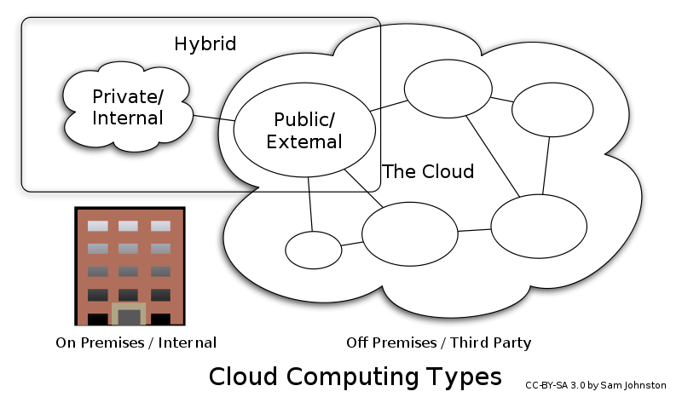
Deployment Models

Slide 23
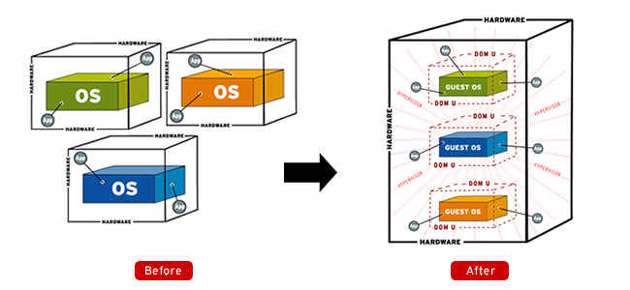
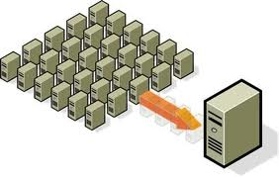
Key Technologies
Virtualization and Clustering are the two key technologies that make up Cloud Computing
Virtualization
(source)
Clustering
(source)

Slide 24
Virtualization
A single computer look like many computers
  The size and power are variable/configurable
  Virtual machines can be migrated without downtime
  Virtual machines enable far more detailed accounting of which applications, LOBs (line-of-business apps), customers are using IT resources

Slide 25
Clustering
Makes many computers (or even virtual machines) look like a single resource
  Huge databases and middleware tiers can be built using powerful, low-cost, high volume components (like blades or rack servers)
  Redundancy of clusters enables high-performance and scalability through parallel operations
  Redundancy also enables inherent high availability, as clusters can survive one or more node failures

Slide 26
Datacenter Utilization
Traditional Enterprise Datacenter utilization is often below 20%

Slide 27
Datacenter Utilization
Virtualization significantly improves average server utilization

Slide 28
Datacenter Utilization
Cloud Computing further increases average server utilization

Slide 29



















Cloud Computing Providers
SaaS
PaaS
IaaS

Slide 30

Who’s using Cloud today?
Mogulus is a live broadcast platform on the internet (cloud customer)
  Producers can use the Mogulus browser-based Studio application to create LIVE, scheduled and on-demand internet television to broadcast anywhere on the web through a single player widget
  http://www.mogulus.com

Slide 31
Who’s using Cloud today?
(continued)
Animoto is a video rendering & production house with service available over the Internet (cloud customer)
  With their patent-pending technology and high-end motion design, each video is a fully customized orchestration of user-selected images and music in several formats, including DVD
Released Facebook App: users were able to easily render their photos into MTV like videos
  Ramped from 25,000 users to 250,000 users in three days
  Signing up 20,000 new users per hour at peak
  Went from 50 to 3500 servers in 5 days
  Two weeks later scaled back to 100 servers
  http://www.animoto.com

Slide 32
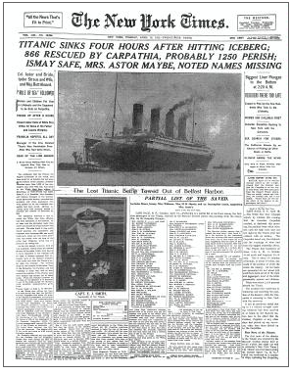
Who’s using Cloud today?
(continued)
Timesmachine is a news archive of the NY Times available in pdf over the Internet to newspaper subscribers (cloud customer)
  Timesmachine needed infrastructure to host several terabits of data
  Internal IT rejected due to cost
  Business owners got the data up on cloud for $50 over one weekend
http://timesmachine.nytimes.com

Slide 33
Who’s using Cloud today?
(continued)
Eli Lilly is the 10th largest pharmaceutical company in the world (cloud customer)
Results:
  Reduced costs
  Global access to R&D applications
  Rapid transition due to VM hosting
  Time to deliver new services greatly reduced:
    New server: 7.5 weeks down to 3 minutes
    New collaboration: 8 weeks down to 5 minutes
    64 node linux cluster: 12 weeks down to 5 minutes

Slide 34
Who’s using Cloud today?
(continued)
Startups & Small businesses
  Can use clouds for everything
  SaaS, IaaS, collaboration services, online presence
Mid-Size Enterprises
  Can use clouds for many things
  Compute cycles for R&D projects, online collaboration, partner integration, social networking, new business tools
Large Enterprises
  More likely to have hybrid models where they keep some things in house
  On premises data for legal and risk management reasons

Slide 35
Cloud Computing Pros and Cons
PROS
Reduced costs
Resource sharing is more efficient
Management moves to cloud provider
Consumption based cost
Faster time to roll out new services
Dynamic resource availability for crunch periods

Slide 36
Cloud Computing Pros and Cons
(continued)
CONS
Compliance/regulatory laws mandate on-site ownership of data
Absence of robust SLAs
Uncertainty around interoperability, portability & lock in
Availability & reliability
Security and privacy

Slide 37
Cloud Computing Conclusion
Cloud Computing is the fastest growing part of IT
Tremendous benefits to customers of all sizes
Cloud services are simpler to acquire and scale up or down
Key opportunity for application and infrastructure vendors
Public clouds work great for some but not all applications
Private clouds offer many benefits for internal applications
Public and private clouds can be used in combination
Economic environment is accelerating adoption of cloud solutions

Slide 38
Resources
www.wikipedia.org
www.oracle.com
www.juniper.net
www.aristanetworks.com

Slide 39

Thank you for your attention

